Slide 1

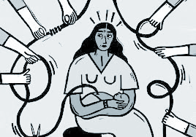

Birth justice
Clinical summer institute
What is Birth Justice?
Safeguards the rights of birthing people to make decisions around their health and the health of their baby, and includes: body autonomy, culturally sensitive care, breast/chest feeding support
What can Social Workers & Clinicians do?
* Engage in culturally informed training using an intersectional lens & relevant theories
* Support clients who experience or at risk of postpartum depression
* Offer grief counseling
* Support clients who need advocacy, & space to process challenges with medical institutions, feelings of oppression and medical racism
Global Foundation for Girls
offers a range of training around Birth Justice & Racial Justice; contact us for more information. Coming Soon: Summer Clinic for Clinicians and Birth Workers:in depth training around Birth Justice, Medical Racism, Culturally Informed Approaches, the role clinicians play in the Birthing Community & around Birthing Trauma and the gaps within our field. Classes are taught by an LCSW and Birth Justice Educators. The institute cohort will meet remote over 8 weekly sessions, once a week for 2 hours a session. CEU credits & completion certification will be offered. Space is limited, contact us for more information at tammea@globalfundgirls.org
Black Women in the U.S. are 3-4x more likely to die in childbirth than their white counterparts.
(MPRC, 2021)
Email: policy@globalfundgirls.org | Instagram: @globalfoundationforgirls
Twitter: @GFoundationGirl | Facebook: GlobalFoundationGirls
LinkedIn: Global Foundation for Girls| Website: https://globalfundgirls.org/

